Slide 1
PyTorch

Slide 2
Topics
Tensors
Devices
Operations
Dataset and Dataloader
Neural Neworks
Architecture
Activation function
Loss function
Optimization and Training loop
Overfitting
Inference
Other layers
Convolution
Pooling
Dropout
CNN architecture
Optimizations
Transfer learnig
Learning rate
Data augmentation
Debugging
TensorBoard
Hooks

Slide 3
Definition
An open-source deep learning framework
Developed by Facebook’s AI Research (FAIR) lab.
Flexible and expressive environment for building neural networks in Python
Designed around eager execution: computations are carried out immediately as operations are invoked, making model development intuitive, debuggable, and well suited for dynamic architectures
A powerful tensor library with GPU acceleration and an automatic differentiation engine
Research experimentation
Production-grade models
Domain-specific libraries: torchvision, torchtext, and torchaudio
Ready-to-use implementations of widely adopted deep learning architectures, such as ResNet, with pretrained weights commonly used for transfer learning.
Rapid adoption in academia and industry: Meta, NVIDIA, Salesforce, Uber, X, rely on PyTorch for a broad range of machine learning applications, from computer vision and natural language processing to reinforcement learning and large-scale model training

Slide 4
PyTorch vs TensorFlow
How computations are defined and executed
Early versions of TensorFlow required to construct a static computation graph and then execute it that graph (declarative style)
Not follow Pythonic conventions (imperative style)
Code less natural to write and harder to debug
Dynamic model behaviour more difficult
changing the architecture on the fly
implementing conditional logic
writing models with variable-length control flows
PyTorch evaluates operations immediately
Rapid adoption of PyTorch in research communities
The landscape has changed: eager execution in TensorFlow 2.x.
Compared with TensorFlow+Keras, PyTorch sits somewhere in the middle.
not a high-level API like Keras
but model definition remains simple and highly expressive
PyTorch’s approach is more intuitive than Keras’s sometimes "magical" behaviour

Slide 5
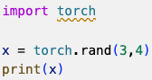
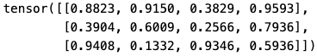
Tensor (1)
A multidimensional array (like a NumPy array)
Support for automatic differentiation
Optimized execution on different hardware backends
Multithreaded BLAS libraries on CPU
CUDA on NVIDIA GPU
MPS on Apple Silicon
We can write hardware-agnostic code while benefiting from architecture-specific optimizations
Every tensor has a rank: its dimensional space
A scalar is as a tensor of rank 0
A vector is rank 1
A N×N matrix is rank 2
…

Slide 6
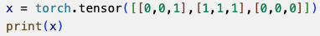
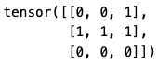
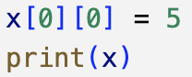
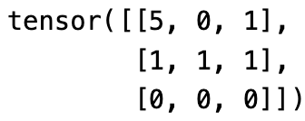
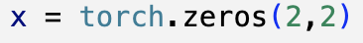
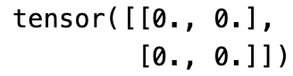
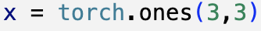
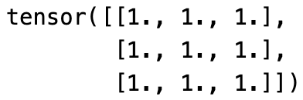
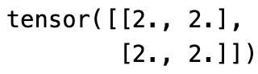
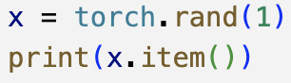
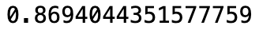
Tensor (2)
We can create tensors from lists
We can change an element by using standard Python indexing:
We can use special creation functions to generate particular tensors
We can perform standard mathematical operations:
If we have a tensor of rank 0, we can pull out the value:

Slide 7
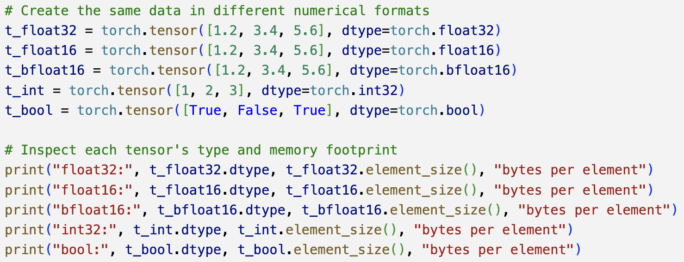
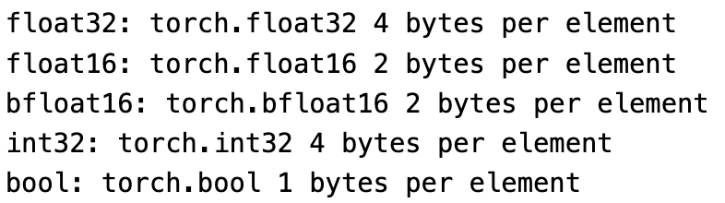
Tensor (3)
Each tensor carries with it a type that defines how it is stored
how much memory occupy
what kinds of operations can be performed
"float32" is a common default because it balances speed and accuracy, while "float16" are useful on accelerators where lower-precision arithmetic can increase throughput
Tensor types encode layout details (stored contiguously, uses strides to more complicated arrangements): usually invisible to write high-level code, but influence performance

Slide 8
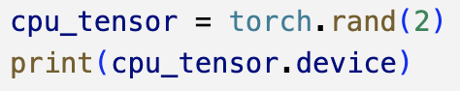
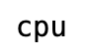
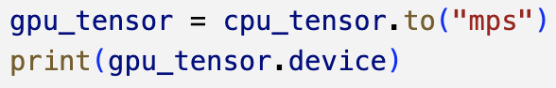
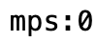
Devices
When we create a tensor, it normally is stored in system memory and being processed by the CPU’s instruction set
As soon as computations grow large, CPU execution becomes a bottleneck
PyTorch’s acceleration model is built around moving tensors to more powerful devices
Machines with NVIDIA GPUs uses thr acceleration provided by CUDA (NVIDIA computing library designed for massively parallel workloads)
Apple Silicon do not support CUDA,but on Metal Performance Shaders MPS (a GPU framework integrated directly into macOS)
The principle is the same: push the tensor onto a fast, parallel device and delegate operations to the underlying backend
The computational model stays simple, while the library adapts to whatever hardware acceleration is available

Slide 9
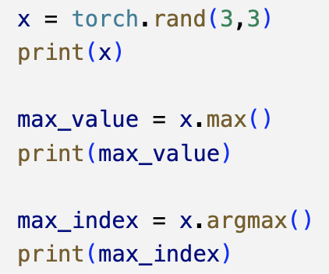
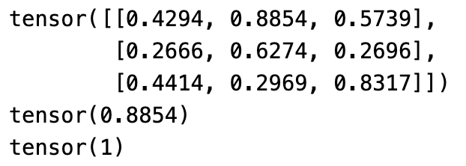
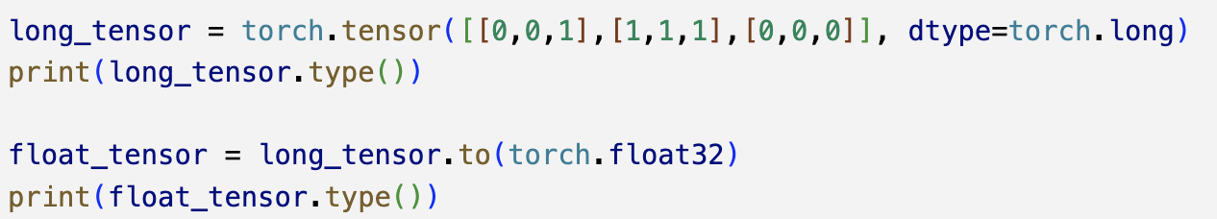
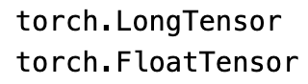
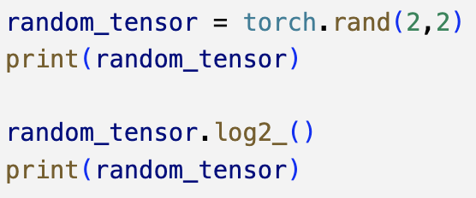
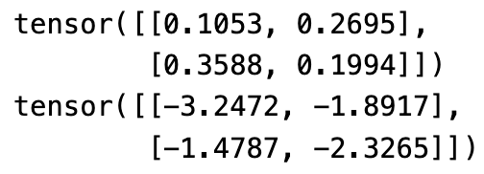
Tensor Operations (1)
Lot of functions: from finding maximum element to Fourier transform
We often need to find the maximum item in a tensor as well as the index that contains the maximum value
Sometimes, we beed change the type of a tensor
Most functions operate on a tensor and return a new tensor. To save memory, we can check if an in-place version of the function existv (same name, with an appended underscore)

Slide 10
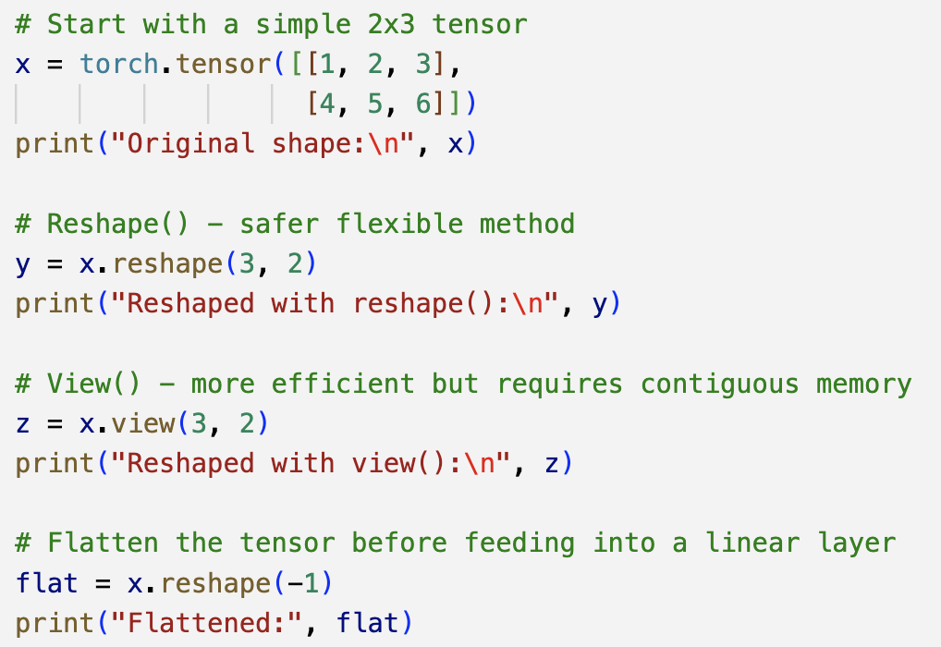
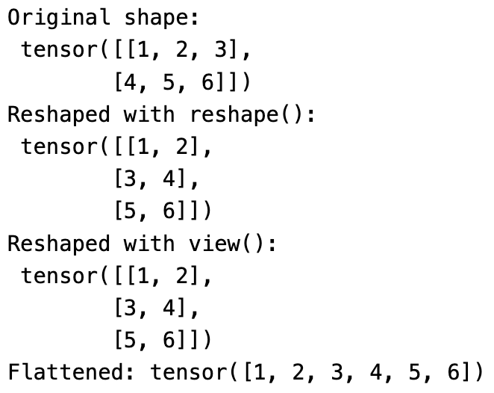
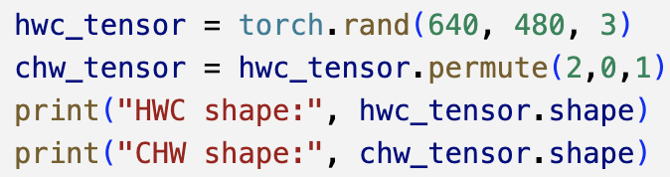
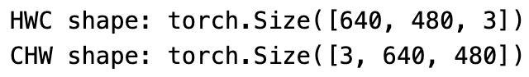
Tensor Operations (2)
Several time we need to reshape data, since NN expect inputs in specific shapes and data cannot match
A convolutional layer might require a 4D tensor
A fully connected layer expects a 2D tensor
Reshaped tensor must have the same number of total elements as the original: otherwise PyTorch raise an error
We might need to rearrange the dimensions of a tensor
Images can be stored as [height, width, channel] but PyTorch prefers [channel, height, width]

Slide 11
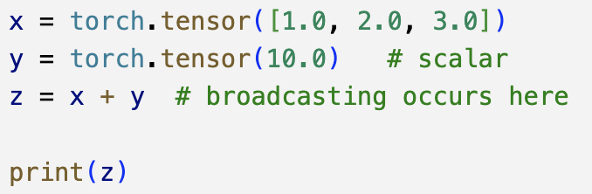
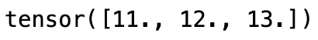
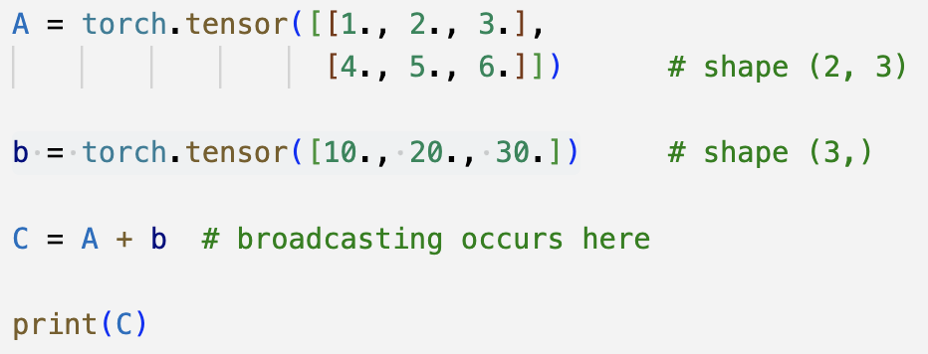
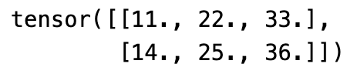
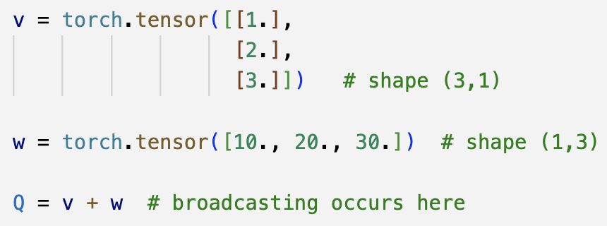
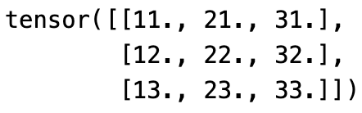
Broadcasting
Allowing tensors with different shapes to be combined
Instead of manually reshape data, PyTorch stretches smaller tensors
No copying of data occurs (expansion is virtual), operations remain efficient
Consider adding a scalar (rank-0) to a vector (rank-1), the scalar is treated as if it were expanded to match the vector shape
Adding a vector (rank-1) to a matrix (rank-2), the vector is broadcasted
A column vector and a row vector are expanded to form a matrix

Slide 12
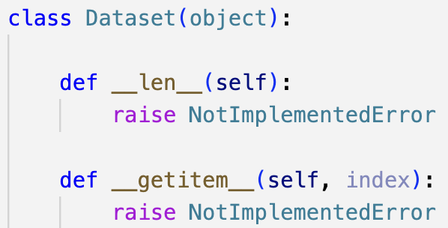
Dataset and DataLoader (1)
A set of standard data-handling conventions that make working with images, text, audio, or any other modality consistent across projects
A dataset is an object that knows how to access the data
How individual samples are retrieved
How labels or metadata are associated with them
A dataloader takes a dataset and handles the practical mechanics of delivering batches of data
How many samples appear in each batch
Whether the data is shuffled
how many worker processes are used to load data in parallel
Any dataset (images, audio clips, text tokens, tabular entries, 3D point clouds, or financial time series) can be made compatible with PyTorch as long as it follows the dataset interface

Slide 13
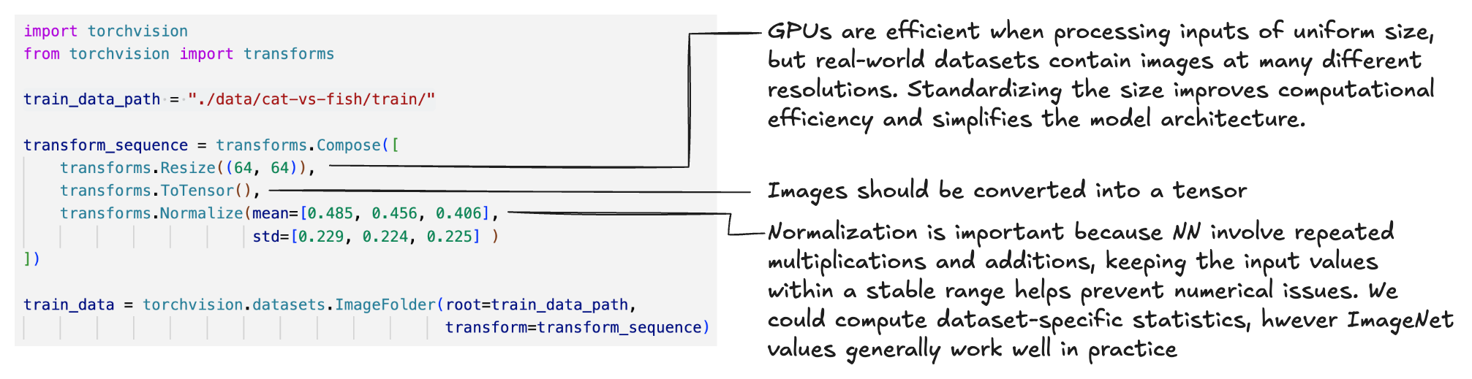

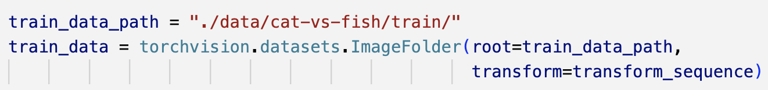
Dataset and DataLoader (2)
Example: Torchvision ImageFolder is a dataset that provides images in a structure where each directory is a label
Allows to specify a list of transforms that will be applied to each image
Default transform is taking image data and turn it into a tensor
Other transforms: resizing, cropping, flipping, rotating, and normalizing
Cats vs. Fish dataset
Dataset from Kaggle, contains images of cats and fish in separate folders obtained from the ImageNet dataset
We need to prepare the training set

Slide 14
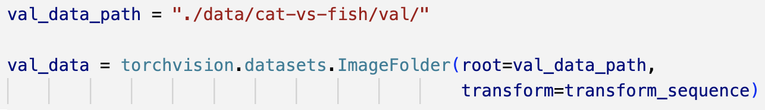
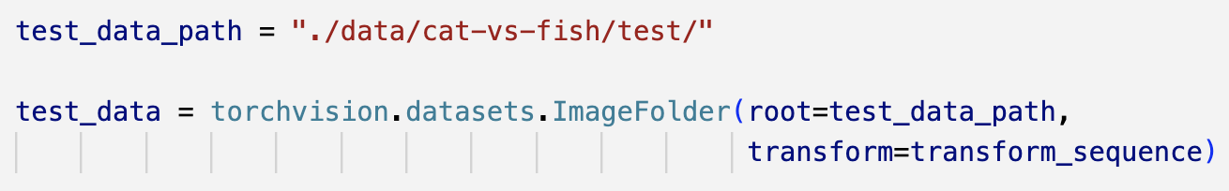
Dataset and DataLoader (3)
We need to prepare the validation set
A major risk is overfitting (a model becomes highly accurate on the examples it has seen during training but fails to generalize to new, unseen data)
After each training cycle (epoch), we evaluate the model on the validation set to check whether its performance is holding up on fresh data rather than just memorizing the training samples
In addition, we should also prepare a test set
Validation set is used during training to monitor performance and tune hyperparameters
Test set provides an unbiased, final evaluation of the model after all training and tuning are complete.
Must contain data that the model has never encountered

Slide 15
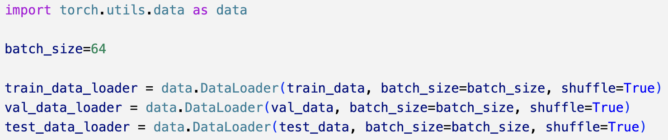
Dataset and DataLoader (4)
With the datasets defined, we can construct the corresponding dataloaders: batching, shuffling, and loading samples efficiently
The key parameter is batch_size
How many samples pass through the network before weights are updated
We could set it equal to the entire training (the network sees all images before each update)
Smaller batches (mini-batches) use less memory and allow the model to update its parameters more frequently (faster training)
Optimal value depends on how much GPU memory is available
We can also adjust several other parameters
whether the data should be shuffled at the start of each epoch
how the dataset should be sampled
how many worker processes are used to load data in parallel

Slide 16
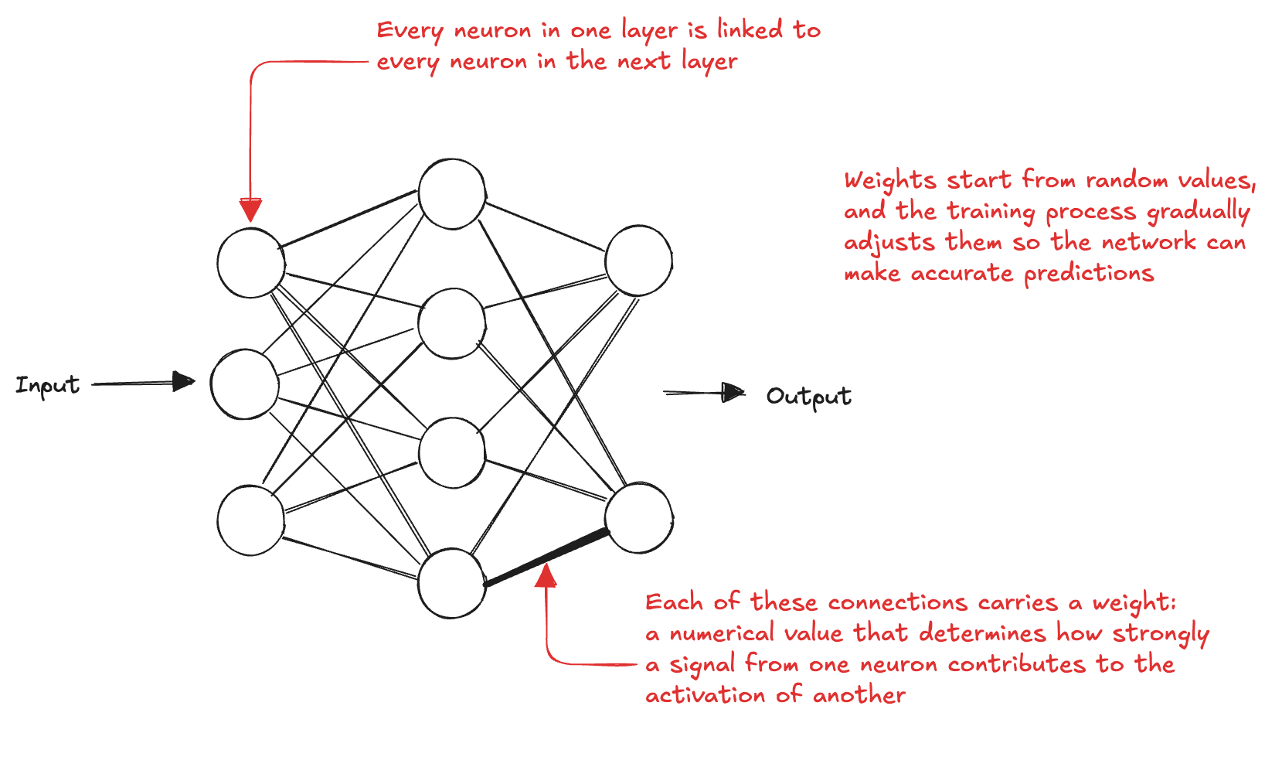
Fully Connected Architecture
We start with a simple fully connected neural network
input layer processes the flattened image tensors
hidden layer learns intermediate representations
output layer matches the number of classes
When an input moves through the network, each layer performs a matrix multiplication between its weight matrix and the incoming activations
General principle: dimensionality shrinks as we move deeper to force the compression of information and learn abstract representations (e.g. features that help distinguish the classes)

Slide 17
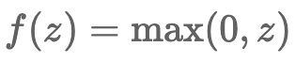
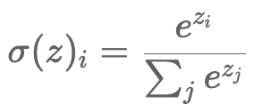
Activation function
The neuron output is passed through an activation function to introduce nonlinearity
even a very deep network collapses into a single linear mapping without nonlinearity
A widely used activation function is the ReLU (Rectified Linear Unit)
Outputs zero for negative inputs
Outputs the input value itself when it is positive
Its derivative is simple and non-small for positive inputs
Makes training stable and efficient
Another important activation function is the softmax function, often used at the output layer of classification networks
Converts a vector of arbitrary real numbers into probabilities
Accentuates differences between values
Commonly used as the final step in multi-class classification

Slide 18
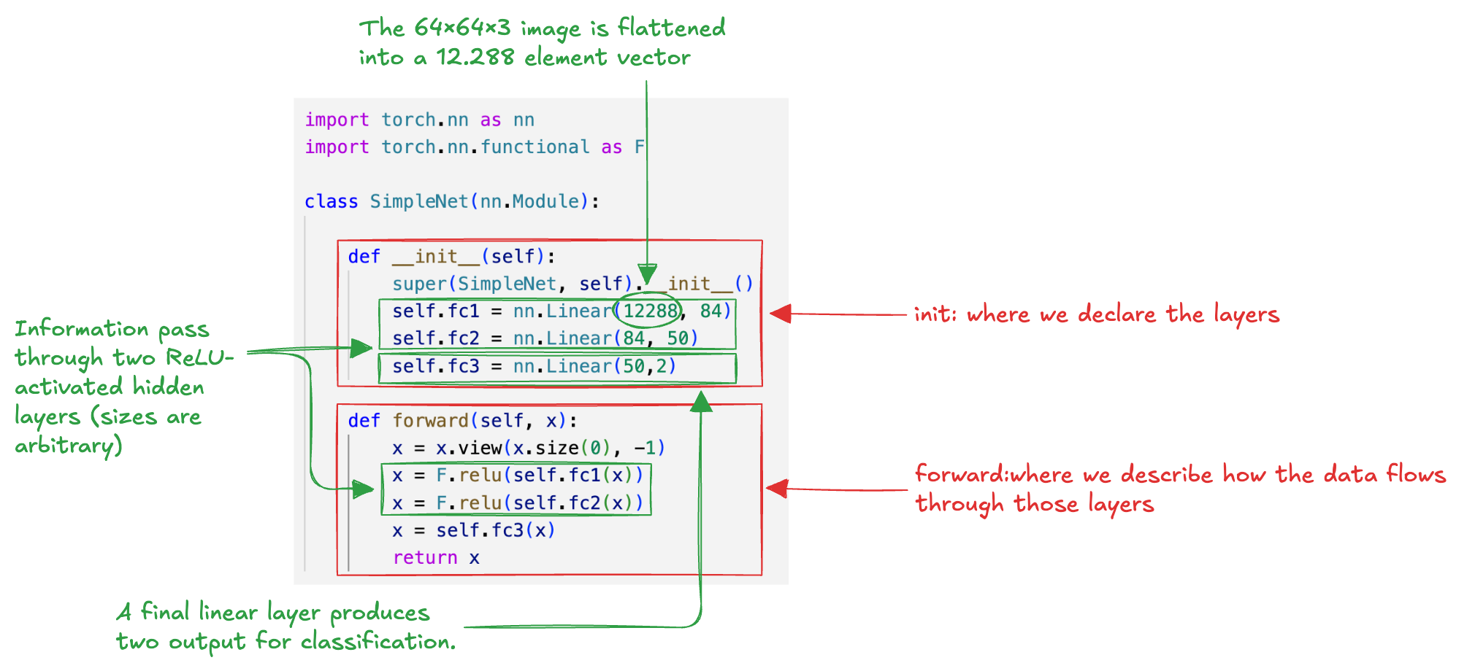
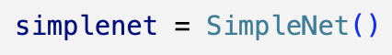
Building a network
We create our model by subclassing torch.nn.Module
We create an instance of the SimpleNN:

Slide 19
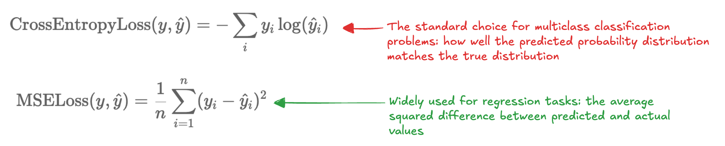
Loss function
Once the network produces a prediction, we can compare it to the true label to determine how accurate it was
We need more than a simple right-or-wrong signal, we need a numeric measure of how wrong the prediction is to guides the NN during training
PyTorch includes a wide range of loss functions suitable for most tasks (classification, regression, sequence modeling, and more) and it also allows us to implement our own
Cross-entropy is ideal for classification because it penalizes confident wrong predictions heavily, while MSE is suited for numerical prediction tasks where we care about the magnitude of the error

Slide 20
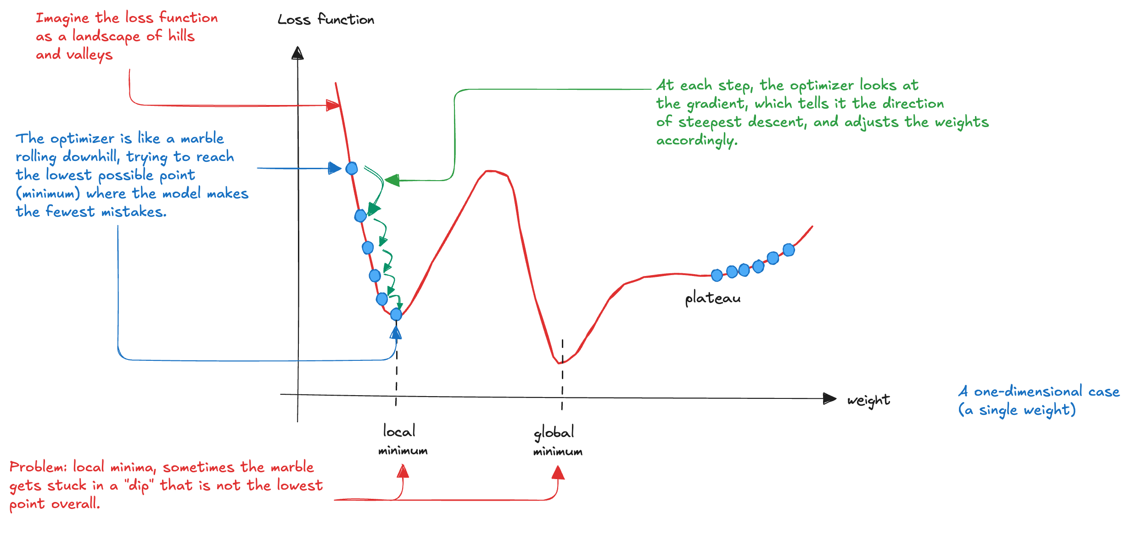
Optimization (1)
Training: repeatedly passing data through the model, measuring how far its predictions deviate from the true labels using the loss function, and adjusting the network’s weights to reduce that loss
Decide how each parameter should move to make the predictions more accurate over time

Slide 21
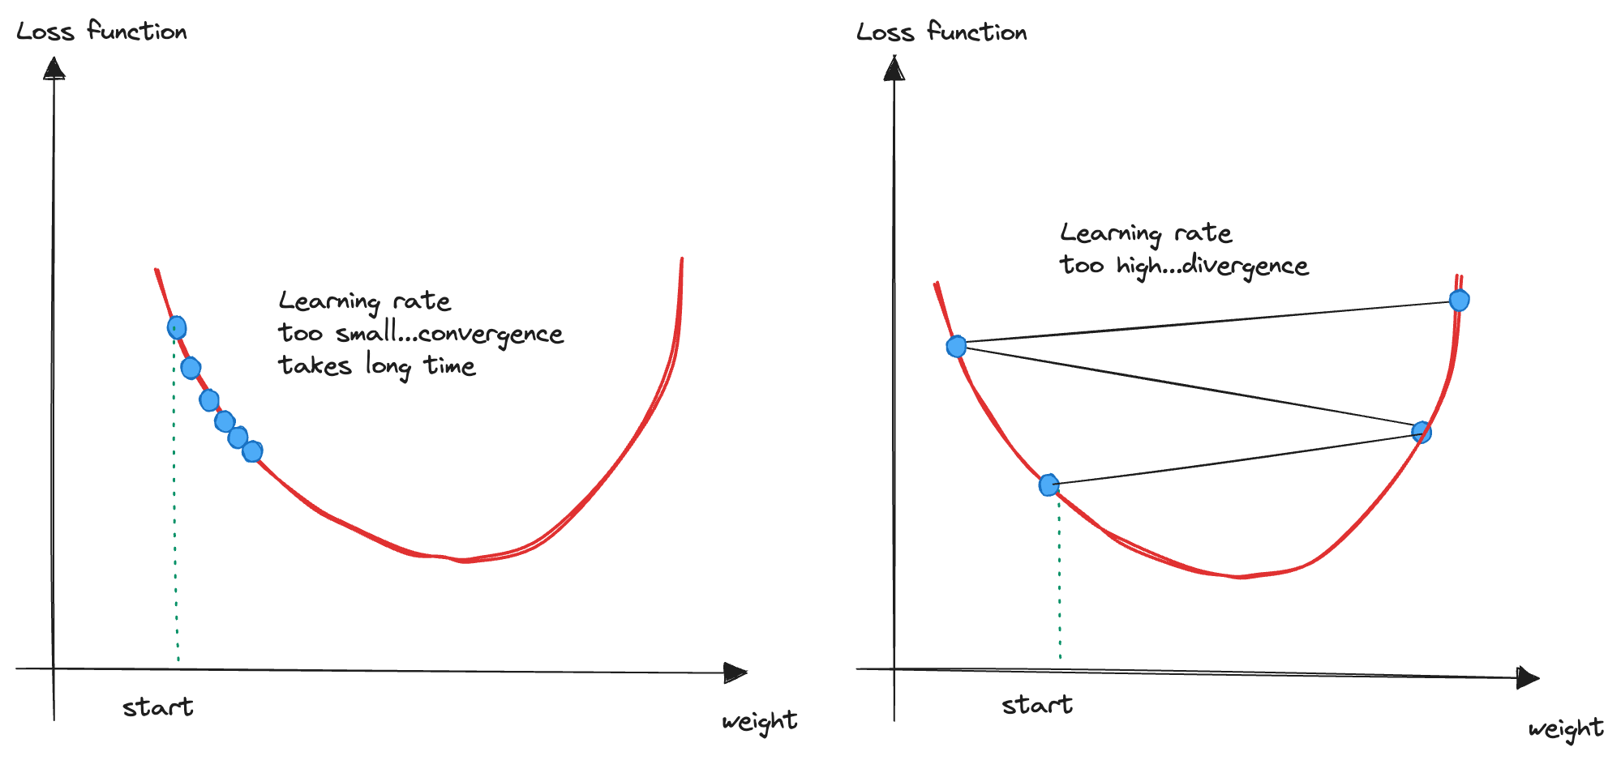
Optimization (2)
If the optimizer takes too large steps, it may overshoot the lowest point and bounce around chaotically
If the steps are too small, training becomes slow or stagnates
The step size is the learning rate and it is essential for efficient training

Slide 22
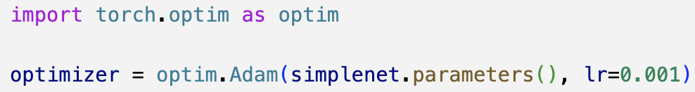
Stochastic Gradient Descent (SGD)
Instead of using the entire dataset to compute the gradient, we use a mini-batch of samples
The randomness introduced by these mini-batches helps the optimizer escape shallow local minima and often leads to better performance.
PyTorch includes several advanced optimizers
AdaGrad
RMSProp
Adam
Creating an optimizer in PyTorch is straightforward
Pass it the parameters of the network along with a chosen learning rate

Slide 23

Training loop
Finally, we put everything together to iteratively improves the model performance by adjusting weights based on batch of data
Once the loop is defined, training simply consists of calling it:

Slide 24

Overfitting
The model become specialized in recognizing images it has seen during training, while losing ability to generalize to new, unseen examples
Divergence between training and validation performance
Fully connected networks have many parameters, the model memorize the training set rather than learning features
Several ways to push back against this
Adding some regularization (dropout, weight decay, or stronger data augmentation)
Early stopping : training is halted around the first few epochs, when the validation loss is at its minimum

Slide 25

Inference
The model has been trained; the final step is to use it to make predictions
We can feed in an image and have the network tell us whether it thinks the image shows a cat or a fish
Generalization error estimation: evaluate performance on the test set that we held out earlier

Slide 26
Saving and Loading
Once we are satisfied with a model performance, we can save its current state using PyTorch built-in serialization utilities
PyTorch relies on Python’s pickle format under the hood
Fully connected NN has the theoretical ability to approximate any function (universal approximation theorem)
In practice, relying on dense networks is rarely ideal

Slide 27

Convolution layer (1)
Images have structure (spatial patterns, local correlations, repeated features) that fully connected layers simply do not exploit
Convolutional Neural Networks (CNN) are explicitly designed to take advantage of the 2D spatial nature of images
We end up with a new 2D array (feature map) that highlights where certain features (as defined by the filter) are found in the original image
Different filters creates multiple feature maps, capturing different aspects of the image (edges, textures, or specific shapes)

Slide 28


Convolution layer (2)
We can control how a convolution operates on an image:
choose the size of the filter
decide how far it moves between applications (stride)
determine what should happen at the edges (padding)
PyTorch supports CNN by the nn.Conv2d layer:
The layer learns the values inside each filter

Slide 29

Pooling layer
Reduce the spatial size of a feature map
Idea: take a small region and replace it with a single summarized value
max, average
Helps the NN to focus on the most important patterns
PyTorch support pooling by the nn.MaxPool2d layer:

Slide 30


Dropout layer
During training, it randomly turn off a fraction of the neurons in a layer
This randomness acts as a powerful regularizer and encourages the network to learn more robust, generalizable representations
PyTorch supports Dropout through the nn.Dropout layer

Slide 31

CNN architecture (1)
Now we can put all the building blocks and create a CNN architecture:
a deep convolutional feature extractor
a fully connected classifier
Notice the use of nn.Sequential to create chain of layers

Slide 32

CNN architecture (2)
We can train the model using the same optimizer and training loop
The test-set evaluation confirms a pattern consistent with what we observed during training and validation
The model has learned useful features

Slide 33

Transfer Learning (1)
Over the last decade, several landmark architectures have been defined
PyTorch includes implementations of many popular CNN models:
AlexNet (2012), GoogLeNet/Inception (2014), VGG (2014), ResNet (2015), etc.
Training these models requires large datasets (often millions of images) and substantial computational resources (days/weeks of GPU time)
We can leverage this power:
Take a model that has already been trained on a large dataset (like ImageNet)
Adapt it to a new, often smaller dataset
Early layers have already learned to detect general features (edges, textures, shapes) that are useful across many visual tasks
By reusing, we can significantly reduce the amount of data and training time required to achieve good performance on a specific task

Slide 34



Transfer Learning (2)
Strat from a model pretrained on ImageNet
Replace the classification layer with a new one tailored to our task
During training, only the new layers are updated, while the backbone is frozen to provide high-quality features learned from ImageNet
Pay attention to the optimizer: we only want to update the new classification layers so we must pass only their parameters

Slide 35

Transfer Learning (3)
Once the new classifier is in place, we simply return to our usual training loop:
The network is already competent at extracting visual features, and the classifier only needs to learn how to map them to "cat" and "fish".
Very fast convergence
High accuracy
Minimal training effort

Slide 36

Learning rate (1)
One of the most important hyperparameters in NN training, yet also one of the hardest to select.
Traditional approaches often rely on trial and error, grid search or rule-of-thumb values
A more systematic alternative is the learning rate range test:
During a single epoch, begin with a very small learning rate
Gradually increase it by multiplying by a constant scaling factor
Record the training loss at each step
Plot the loss against the learning rate
Visually identify the optimal learning rate
We select a learning rate that is neither too small (leading to slow convergence) nor too large (causing instability)
The loop is essentially a normal training loop, except that the learning rate is gradually increased after each batch.

Slide 37

Learning rate (2)

Slide 38

Data augmentation (1)
Overfitting happens when a model learns the training, essentially memorizing it, rather than discovering patterns that generalize
A classic defense is simply to gather more data
But what if we have only a limited dataset?
Transforming samples in ways that preserve their meaning, we can artificially expand the diversity of the dataset

Slide 39


Data augmentation (2)
Torchvision provides a rich set of built-in transforms for data augmentation
We can define custom transforms

Slide 40

TensorBoard (1)
A web-based application that makes easy to visualize training
Monitor accuracy, losses, activation values, and any statistic
All in real time
Originally developed for TensorFlow, its interface is general and simple:
To show the TensorBoard, we simply point it to the directory where the log files are stored

Slide 41


TensorBoard (2)
We can integrate the logging into a loop as follows:
We can replace the print statements in the training loop by logging the values directly to TensorBoard, gaining a clearer and interactive view of how the model is learning:

Slide 42

TensorBoard (3)
TensorBoard can display the model architecture, giving a visual representation of the network we’re training.
It works by tracing a forward pass:
TensorBoard shows layers, shapes, and how data flows through the network

Slide 43



Hooks (1)
Functions we can attach to PyTorch to be executed during the forward or backward pass
Whenever PyTorch reaches a module with a registered hook, it automatically calls that hook, allowing us to inspect or modify what is happening inside the network
Hooks are extremely powerful:
observe what happens inside a network as inputs move through its layers.
overwrite activations
alter gradients
mask values
modify biases
implement entirely custom behaviour

Slide 44



Hooks (2)
Class activation mapping: a technique used to visualize which regions of an input the network focused on when making a prediction
We can grab information from the activations of the last convolutional layer (just before the fully connected classifier)
Contain the highest-level spatial information extracted
Reveals what the model considers important in the image
In our architecture, we can use "layer3”
We define a forward hook to captures this feature maps and a backward hook which provides the gradients flowing, telling us how strongly each map contributed to that specific prediction

Slide 45



Hooks (3)
We load an image from the test set in order to run a forward and a backward pass through the network and capture the data for CAM generation:
The gradients tell us how much changing each activation in the last convolutional layer would affect the score of the chosen class

Slide 46




Hooks (4)
We combine channels by taking a weighted sum, amplifying the feature maps that mattered most and suppressing the ones that mattered least.
This produces a single 2D map that reflects where the important visual evidence is located in the image
Finally, applying a ReLU removes negative contributions, keeping only regions that positively support the prediction and normalization rescales the values so they can be visualized as a heatmap

